Slide 1



Department of Electronics and Communication Engineering
Team Vibhav
AR Education
Total Cost of the Project: Null

Slide 2


Overview:
About the Project
Problem the Project solves
Solution to the problem
Techstack
Novelty of the solution
Applications
Social Applications
Business Aspects

Slide 3

About the Project:
The approach of the project is interactive, innovative and quintessentially holistic . The project deals with making students visualise concepts in 3D. AR education will help students to comprehend concepts they learn thoroughly in an easy way.

Slide 4
Problem the Project solves:
It provides a common platform for students from different background to learn and explore concepts of their interest.
Apart from it also promotes home learning which is need of the hour in this period of turmoil.

Slide 5
Solution to the problem:
It gives students the privilege to see, observe and feel at the same time while learning.
It will help students with poor financial background who cannot afford coaching.
It provides opportunity to learn beyond class, one can learn effectively from home itself.

Slide 6



Softwares Used: (Techstack)
Unity: It is a professional level game engine that allows you to build massive 3D and 2D games for any platform.
Blender: It is 3D computer graphics software used for creating visual effects and 3D printed models.
AR Core: It is a Google’s platform for building Augmented Reality experiences.

Slide 7
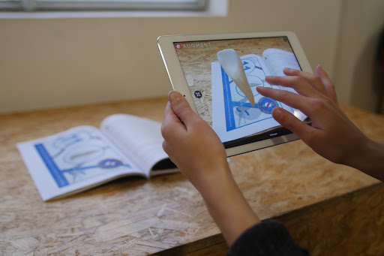
Novelty of the Solution:
Our idea is one of it’s kind. Using AR/VR technology our project will provide interaction with the 3D models. It is basically like our classroom that can be accessed from anywhere , with user friendly interactive platform. Apart from this it will maintain equity among students, to avail the resources.

Slide 8
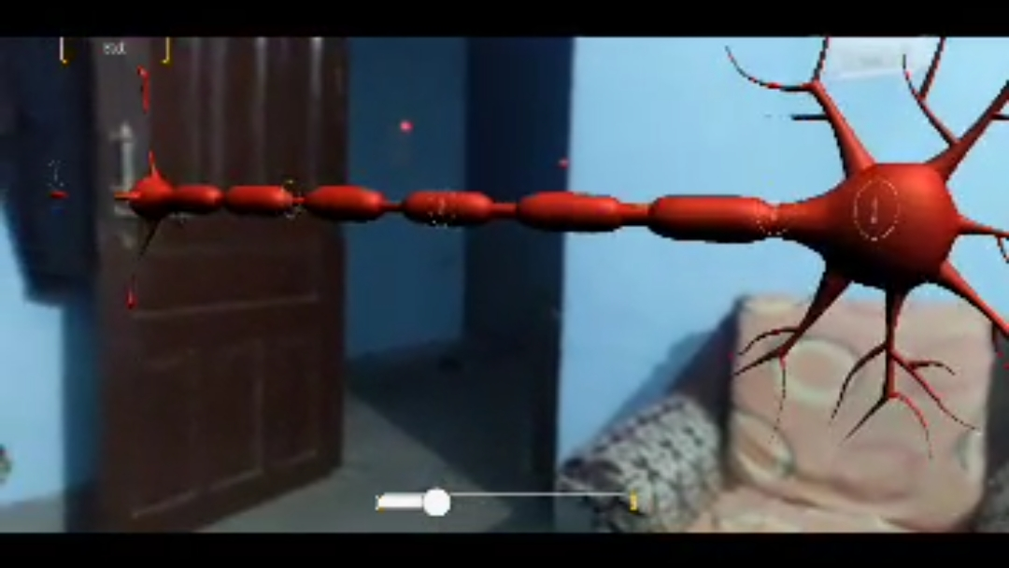
Applications:
1)Book Visualizer :
In depth learning of some important concepts of science by visualizing the phenomenon. The image of object or concept in 3D will help students for better understanding of phenomenon.

Slide 9
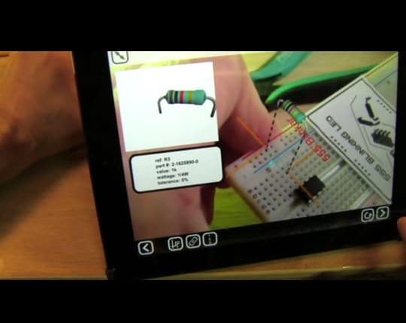
Applications:
2)Circuits:
3D representation of various circuits for better visualisation and understanding of students to make their learning much effective and interactive.

Slide 10
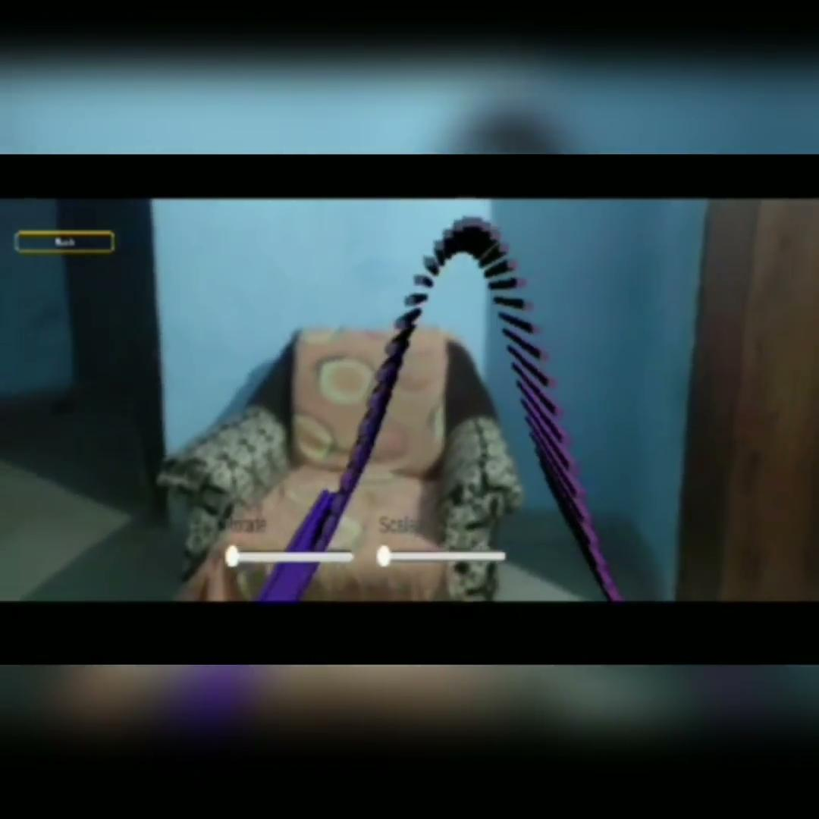
Applications:
3) Mathematical Concepts:
Concepts like mathematical equations and graphs, conic sections and visualisation of geometric figures like sphere, cylindrical figures. It will predominantly benefit core topics that include various graphs and 3D curves.

Slide 11

Social Applications:
Students whose education have been compromised due to this pandemic will no longer lack the practical education of the subjects.
With growing AR technology this project will be useful to accomplish many targets in the educational field to teach students virtually .
It will also help students with poor financial background to comprehend basic concepts of various subjects easily.

Slide 12
Business
Aspects:
This project is common platform for all the subjects. Students can avail all the resources of any subject under this single application.
It is very easy to use, portable and cost effective. It can work on both mobile and computer that will further help students to avail the resources easily.

